Slide 1


Francisco Salinas
24/10/2023

Slide 2

Outline
Executive Summary
Introduction
Methodology
Results
Conclusion
Appendix

Slide 3
Executive Summary
The following methodologies were used to analyze data:
Data Collection using web scraping and SpaceX API;
Exploratory Data Analysis (EDA), including data wrangling, data visualization and interactive visual analytics;
Machine Learning Prediction.
Summary of all results
It was possible to collected valuable data from public sources;
EDA allowed to identify which features are the best to predict success of launchings;
Machine Learning Prediction showed the best model to predict which characteristics are important to drive this opportunity by the best way, using all collected data.

Slide 4
Introduction
Project background and context
Space X advertises Falcon 9 rocket launches on its website with a cost of 62 million dollars; other providers cost upward of 165 million dollars each, much of the savings is because Space X can reuse the first stage. Therefore, if we can determine if the first stage will land, we can determine the cost of a launch. This information can be used if an alternate company wants to bid against space X for a rocket launch. This goal of the project is to create a machine learning pipeline to predict if the first stage will land successfully.
Problems you want to find answers
What factors determine if the rocket will land successfully?
The interaction amongst various features that determine the success rate of a successful landing.
What operating conditions needs to be in place to ensure a successful landing program.

Slide 5

Section 1

Slide 6
Methodology
Executive Summary
Data collection methodology:
Data from Space X was obtained from 2 sources:
Space XAPI(https://api.spacexdata.com/v4/rockets/)
WebScraping (https://en.wikipedia.org/wiki/List_of_Falcon/_9/_and_Falcon_Heavy_launches)
Perform data wrangling
Collected data was enriched by creating a landing outcome label based on outcome data after summarizing and analyzing features
Perform exploratory data analysis (EDA) using visualization and SQL
6

Slide 7
Methodology
Executive Summary
Perform interactive visual analytics using Folium and Plotly Dash
Perform predictive analysis using classification models
Data that was collected until this step were normalized, divided in training and test data sets and evaluated by four different classification models, being the accuracy of each model evaluated using different combinations of parameters.
7

Slide 8



Data Collection – SpaceX API
We used the get request to the SpaceX API to collect data, clean the requested data and did some basic data wrangling and formatting.
The link to the notebook is:
https://github.com/resh1704/Applied-Data-Science-Capstone-IBM-SPACEX/blob/main/Data%20Collection%20API.ipynb
Request API and parse the SpaceX launch data
Filter data to only include Falcon 9 launches
Deal with Missing Values

Slide 9


Data Collection - Scraping
We applied web scrapping to webscrap Falcon 9 launch records with BeautifulSoup
We parsed the table and converted it into a pandas dataframe.
The link to the notebook is https://github.com/resh1704/Applied-Data-Science-Capstone-IBM-SPACEX/blob/main/Data%20Collection%20with%20Web%20Scraping.ipynb
Request the Falcon9 Launch Wiki page
Extract all column/variable names from the HTML table header
Create a data frame by parsing the launch HTML tables

Slide 10




Data Wrangling
We performed exploratory data analysis and determined the training labels.
We calculated the number of launches at each site, and the number and occurrence of each orbits
We created landing outcome label from outcome column and exported the results to csv.
Source: https://github.com/resh1704/Applied-Data-Science-Capstone-IBM-SPACEX/blob/main/Data%20Wrangling.ipynb
Creation of Landing Outcome Label
EDA
Summarizations

Slide 11


EDA with Data Visualization
The link to the notebook is https://github.com/resh1704/Applied-Data-Science-Capstone-IBM-SPACEX/blob/main/EDA%20with%20Data%20Visualization.ipynb
We explored the data by visualizing the relationship between flight number and launch Site, payload and launch site, success rate of each orbit type, flight number and orbit type, the launch success yearly trend.

Slide 12
EDA with SQL
We loaded the SpaceX dataset into a PostgreSQL database without leaving the jupyter notebook.
We applied EDA with SQL to get insight from the data. We wrote queries to find out for instance:
The names of unique launch sites in the space mission.
The total payload mass carried by boosters launched by NASA (CRS)
The average payload mass carried by booster version F9 v1.1
The total number of successful and failure mission outcomes
The failed landing outcomes in drone ship, their booster version and launch site names.
The link to the notebook is https://github.com/resh1704/Applied-Data-Science-Capstone-IBM-SPACEX/blob/main/EDA%20with%20SQL.ipynb

Slide 13
Build an Interactive Map with Folium
We marked all launch sites, and added map objects such as markers, circles, lines to mark the success or failure of launches for each site on the folium map.
We assigned the feature launch outcomes (failure or success) to class 0 and 1.i.e., 0 for failure, and 1 for success.
Using the color-labeled marker clusters, we identified which launch sites have relatively high success rate.
We calculated the distances between a launch site to its proximities. We answered some question for instance:
Are launch sites near railways, highways and coastlines.
Do launch sites keep certain distance away from cities.
Source: https://github.com/resh1704/Applied-Data-Science-Capstone-IBM-SPACEX/blob/main/Interactive%20Visual%20Analytics%20with%20Folium.ipynb

Slide 14
Build a Dashboard with Plotly Dash
We built an interactive dashboard with Plotly dash
We plotted pie charts showing the total launches by a certain sites
We plotted scatter graph showing the relationship with Outcome and Payload Mass (Kg) for the different booster version.
This combination allowed to quickly analyze the relation between payloads and launch sites, helping to identify where is best place to launch according to payloads.
Source: https://github.com/resh1704/Applied-Data-Science-Capstone-IBM-SPACEX/blob/main/app.py

Slide 15





Predictive Analysis (Classification)
We loaded the data using numpy and pandas, transformed the data, split our data into training and testing.
We built different machine learning models and tune different hyperparameters using GridSearchCV.
We used accuracy as the metric for our model, improved the model using feature engineering and algorithm tuning.
We found the best performing classification model.
Source: https://github.com/resh1704/Applied-Data-Science-Capstone-IBM-SPACEX/blob/main/Machine%20Learning%20Prediction.ipynb
Test of each model with combinations of hyperparameters
Data preparation and standardization
Comparison of
results

Slide 16
Results
Exploratory data analysis results:
Space Xuses 4 different launch sites;
The first launches were done to Space Xitself and NASA;
The average payload of F9 v1.1 booster is 2,928 kg;
The first success landing outcome happened in 2015 fiver year after the first launch;
Many Falcon 9 booster versions were successful at landing in drone ships having payload above the average;
Almost 100% of mission outcomes were successful;
Two booster versions failed at landing in drone ships in 2015: F9 v1.1 B1012 and F9 v1.1 B1015;
The number of landing outcomes became as better as years passed.

Slide 17
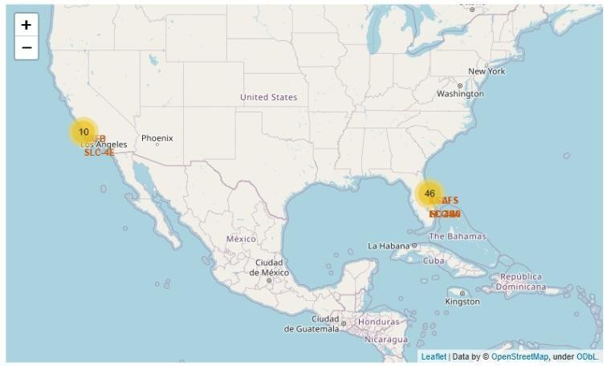
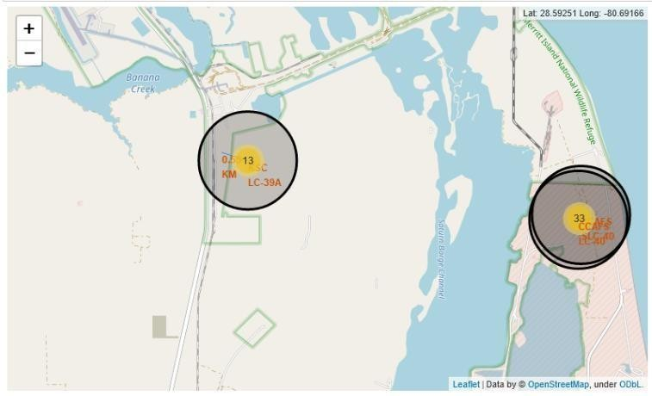
Results
Using interactive analytics was possible to identify that launch sites use to be in safety places, near sea, for example and have a good logistic infrastructure around.
Most launches happens at east cost launch sites.

Slide 18
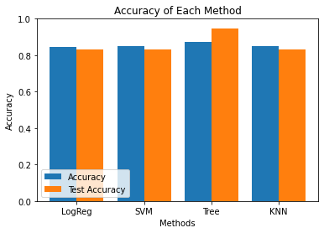
Results
Predictive Analysis showed that Decision Tree Classifier is the best model to predict successful landings, having accuracy over 87% and accuracy for test data over 94%.

Slide 19

Section 2

Slide 20

Flight Number vs. Launch Site
From the plot, we found that the larger the flight amount at a launch site, the greater the success rate at a launch site.

Slide 21
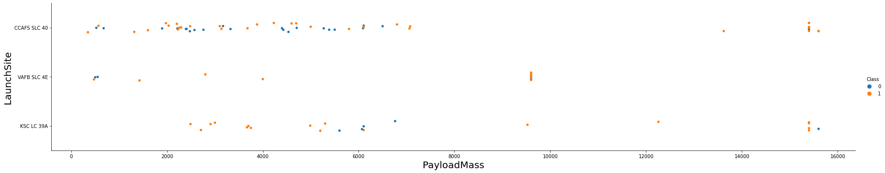
Payload vs. Launch Site
Payloads over 9,000kg (about the weight of a school bus) have excellent success
rate;
Payloads over 12,000kg seems to be possible only on CCAFSSLC40 and KSC LC 39A launch sites.

Slide 22

Success Rate vs. Orbit Type
The biggest success rates happens to orbits:
ES-L1;
GEO;
HEO; and
SSO.
Followed by:
VLEO (above 80%); and
LFO (above 70%).

Slide 23
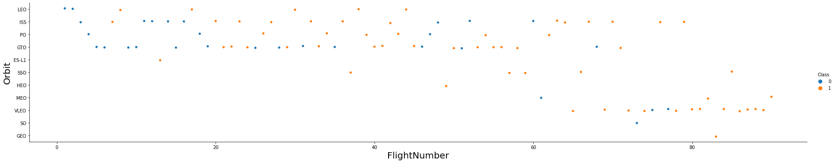
Flight Number vs. Orbit Type
Apparently, success rate improved over time to all orbits;
VLEO orbit seems a new business opportunity, due to recent increase of its
frequency.

Slide 24
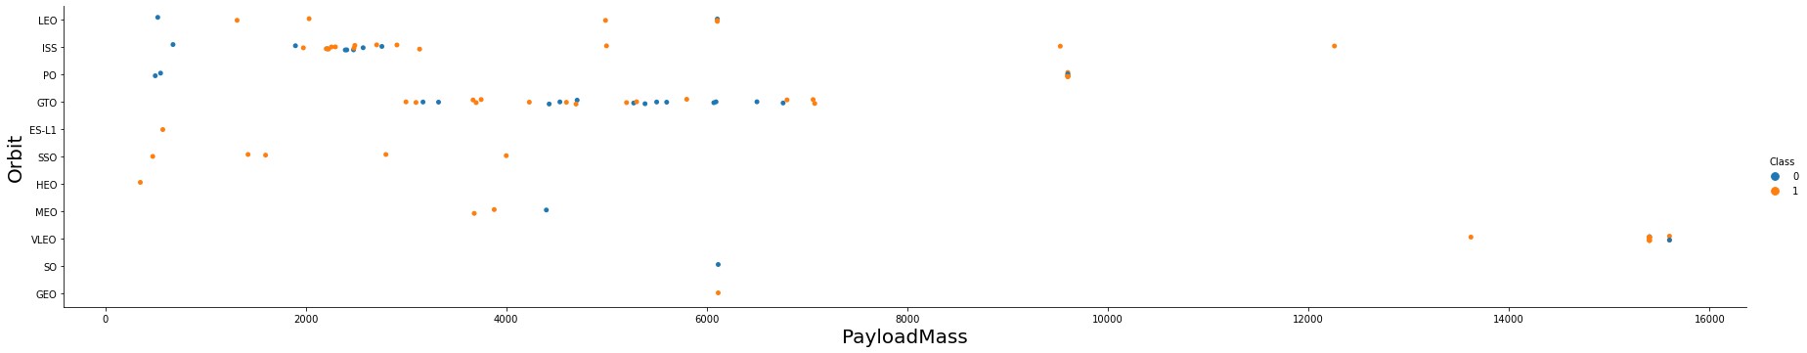
Payload vs. Orbit Type
Apparently, there is no relation between payload and success rate to orbit GTO;
ISSorbit has the widest range of payload and a good rate of success;
There are few launches to the orbits SOand GEO.

Slide 25
Launch Success Yearly Trend
Success rate started increasing in 2013 and kept until 2020;
It seems that the first three years were a period of adjusts and improvement of technology.

Slide 26

All Launch Site Names
According to data, there are four launch sites
They are obtained by selecting unique occurrences of “launch_site” values from the dataset.

Slide 27

Launch Site Names Begin with 'CCA'
We used the query above to display 5 records where launch sites begin with `CCA`

Slide 28

Total Payload Mass
Total payload carried by boosters from NASA:

Slide 29

Average Payload Mass by F9 v1.1
Filtering data by the booster version above and calculating the average payload mass we obtained the value of 2,928 kg.

Slide 30

First Successful Ground Landing Date
By filtering data by successful landing outcome on ground pad and getting the minimum value for date it’s possible to identify the first occurrence, that happened on 12/22/2015.

Slide 31

Successful Drone Ship Landing with Payload between 4000 and 6000
Boosters which have successfully landed on drone ship and had payload mass greater than 4000 but less than 6000
Selecting distinct booster versions according to the filters above, these 4 are the result.

Slide 32

Total Number of Successful and Failure Mission Outcomes
Number of successful and failure mission outcomes
Grouping mission outcomes and counting records for each group led us to the summary .

Slide 33

Boosters Carried Maximum Payload
Boosters which have carried the maximum payload mass
These are the boosters which have carried the maximum payload mass registered in the dataset.

Slide 34

2015 Launch Records
Failed landing outcomes in drone ship, their booster versions, and launch site names for in year 2015
The list below has the only two occurrences

Slide 35

Rank Landing Outcomes Between 2010-06-04 and 2017-03-20
Ranking of all landing outcomes between the date 2010-06-04 and 2017- 03-20.
This view of data alerts us that “No attempt” must be taken in account.

Slide 36

Section 3

Slide 37
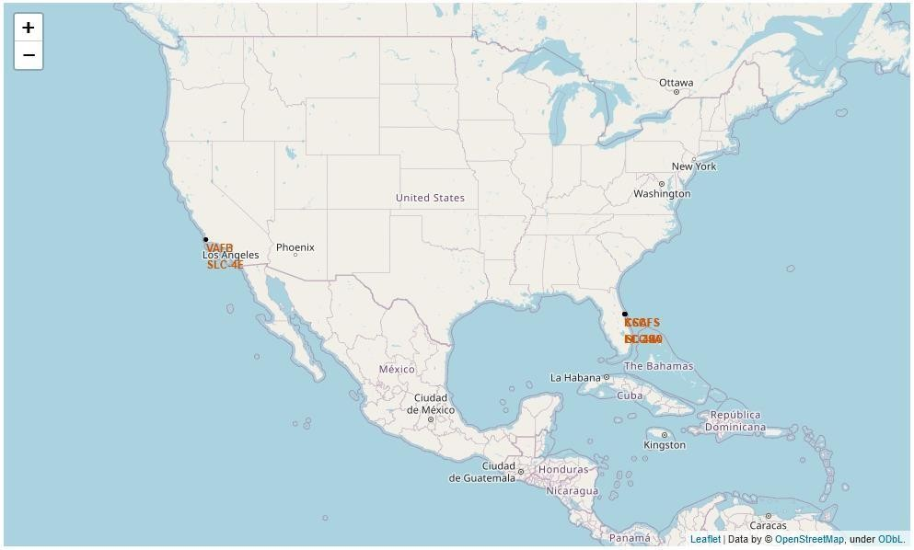
<Folium Map Screenshot 1>
Launch sites are near sea, probably by safety, but not too far from roads and railroads.

Slide 38
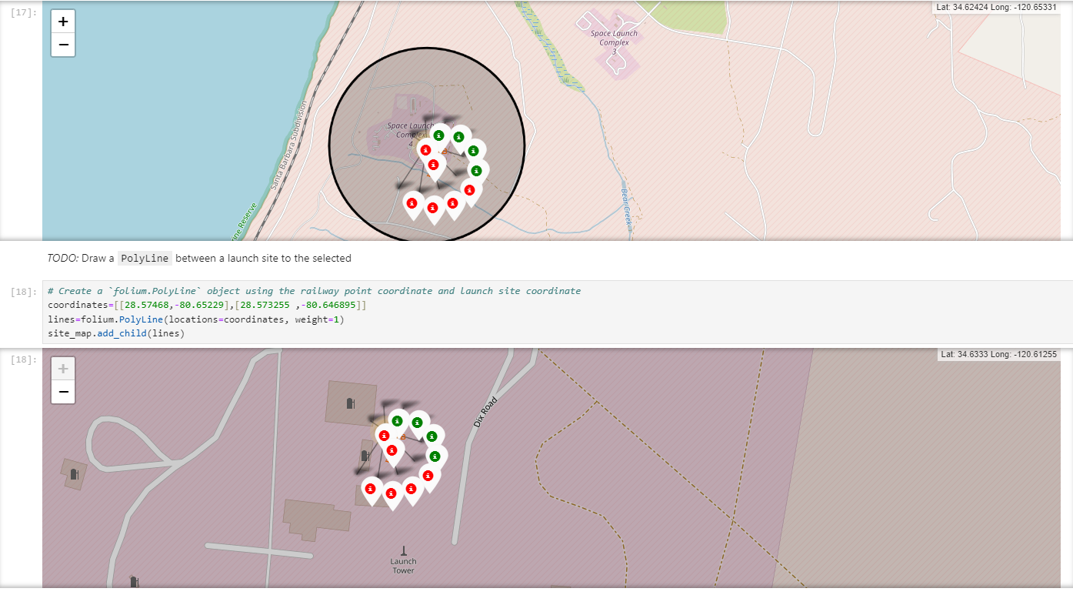
<Folium Map Screenshot 2>
Green markers indicate successful and red ones indicate failure

Slide 39
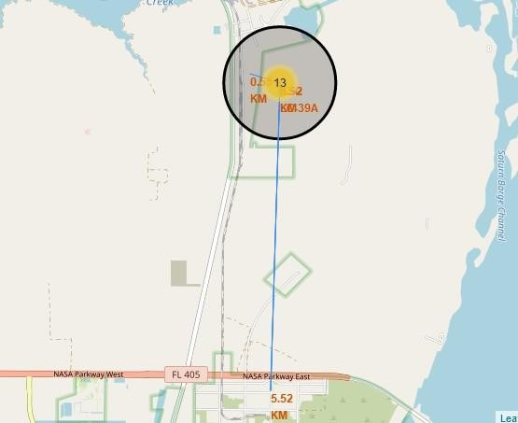
<Folium Map Screenshot 3>
Launch site KSCLC-39A has good logistics aspects, being near railroad and road and relatively far from inhabited areas.

Slide 40

Section 4

Slide 41
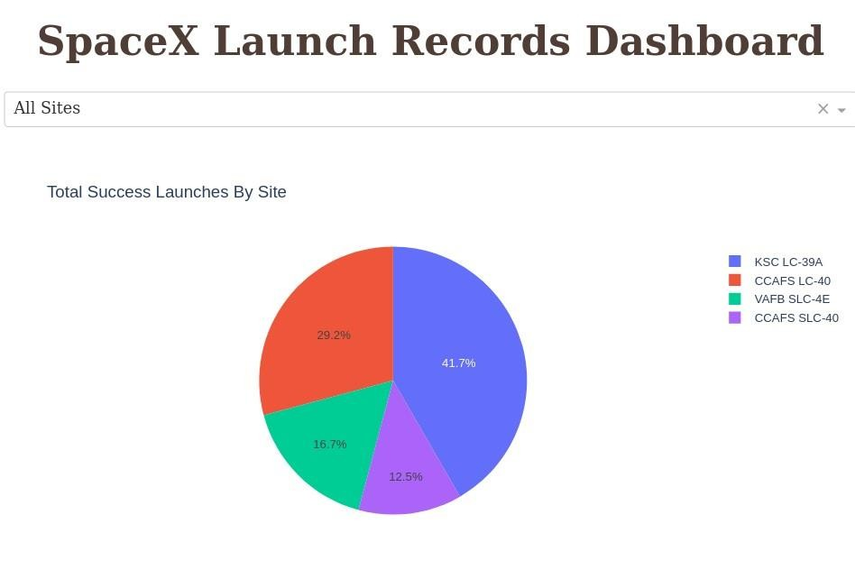
Successful Launches by Site
The place from where launches are done seems to be a very important factor of
success of missions.

Slide 42
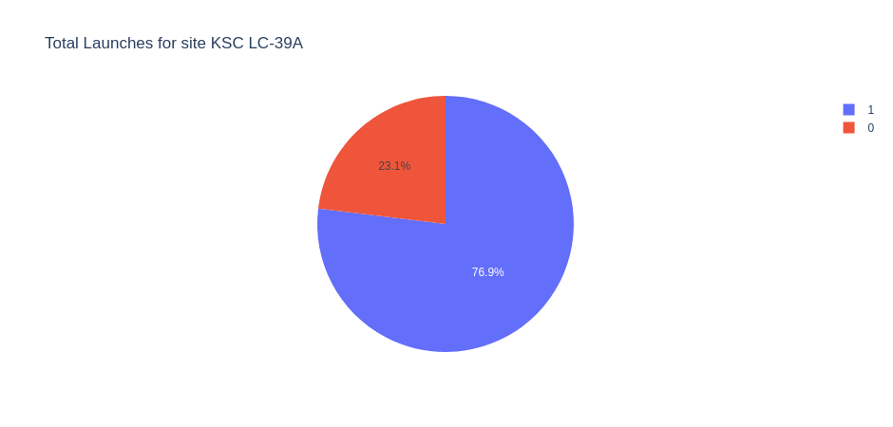
Launch Success Ratio for KSCLC-39A
76.9% of launches are successful in this site.

Slide 43

Payload vs. Launch Outcome

Slide 44

Section 5

Slide 45
Classification Accuracy
Four classification models were tested, and their accuracies are plotted beside;
The model with the highest classification accuracy is Decision Tree Classifier, which has accuracies over than 87%.

Slide 46

Confusion Matrix
The confusion matrix for the decision tree classifier shows that the classifier can distinguish between the different classes. The major problem is the false positives .i.e., unsuccessful landing marked as successful landing by the classifier.

Slide 47
Conclusions
Different data sources were analyzed, refining conclusions along the
process;
The larger the flight amount at a launch site, the greater the success rate at a launch site.
The best launch site is KSCLC-39A;
Launches above 7,000kg are less risky;
Although most of mission outcomes are successful, successful landing outcomes seem to improve over time, according the evolution of processes and rockets;
Decision Tree Classifier can be used to predict successful landings and
increase profits.

Slide 48
Appendix
I preferred to do all the notebooks using jupyter lab and not notebook directly from the prompt and not in an IDLE.

Slide 49


